Slide 1
Introduction - Project Planning
- Making Presentations
CSW 2011
Stefano Pirandola

Slide 2
Aims
Immediate aims:
To help prepare for your project work
  Planning your project
  Planning your project report
  Structuring the overall write up, how to do a literature review
  Prepare for project presentation
Longer terms aims:
Being prepared on how to plan work, write reports, make presentations in your future work

Slide 3
Who’s here, doing what?
Undergraduate students (on CS projects, PR3/4)
  Attend lectures and practicals
  Give presentation (mark does not count, but detailed feedback will be given)
MSc/Meng students
  Attend lectures and practicals
  Open assessment (lit review - due in Spring)
  Give presentation (on aspect of lit review - in Spring)

Slide 4
Module Activities
Lectures
- 10 Lectures. See website for timetable and lecture notes.
- Besides me, other 4 lecturers:
Alistair Edwards, Jeremy Jacob, Dan Franks, Tony Wilson
Presentations
- Undergraduate students give their presentations in week 3
- One or two key papers from your project literature review, a critical analysis of these paper/s
- 8 minutes for presentation + 2 minutes for questions
- More details on the website
- Graduate students give their presentations in Spring term
Practicals
- Exercise sheet on Latex (week 4). Online lit resources (week 5)

Slide 5
In this lecture….
Key-points of CS projects
Project planning (Gantt, PERT charts)
Making academic presentations

Slide 6
What is a project ?
Demonstrates your ability to conduct a sustained piece of work, use computer science techniques, following …
An appropriate development lifecycle. Usually:
  Requirements - design - implementation - evaluation (don’t forget evaluation!) - maintenance
  Including producing some kind of “artifact” - software, hardware, training materials …
BSc projects do not need to “increase knowledge”, MSc/MEng projects do

Slide 7
Projects and Knowledge
KNOWLEDGE
PR3
MEng
After Dawson, 1999

Slide 8
Methods for projects
Different methods are appropriate for different projects
  Software Engineering methods - agile programming, RAD, unified process etc
  Hardware methods for specification/design
  Research method: problem-hypothesis-experiment
  Algorithm design/proof: problem-plan-do
Method is very important
  In your project report, you need to justify why you chose particular methods
  What alternatives are available to you?
  Discuss with your supervisor if necessary

Slide 9

Planning for a project
Who has used a Gantt chart?
Not an acronym: Mr. Henry Gantt, mechanical engineer, developed the diagrams for the Hoover dam and other big projects
Can do one manually with spreadsheet programs (Excel)

Slide 10
Gantt chart
Basic elements of the chart
Tasks (for a complex project, tasks are grouped into work packages). Duration of tasks. Staff involved.
Milestones - key points when things will be achieved (e.g. “agree title with supervisor”)
Deliverables - artifacts and components of artifacts to be produced - components of software, chapters/drafts of report

Slide 11
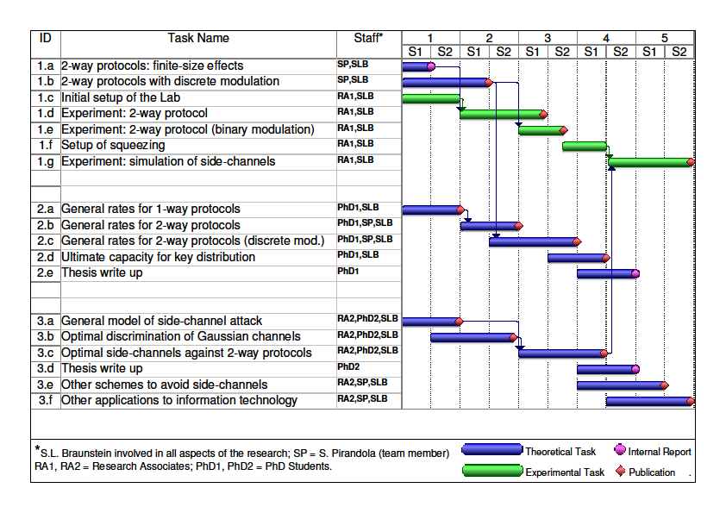
“Real Example” (from a research proposal)

Slide 12
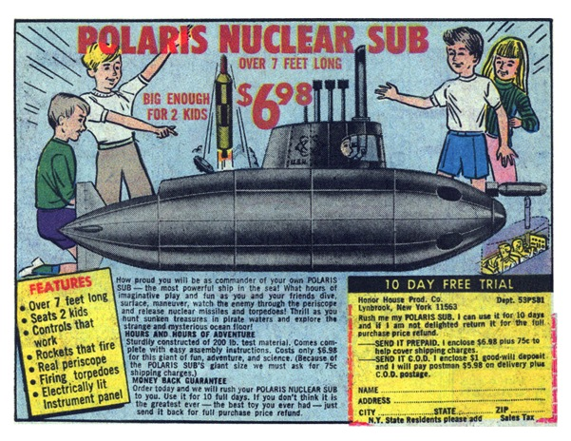
Pert charts
First developed to support the U.S. Navy's Polaris nuclear submarine project (1957)
www.comixstuff.com

Slide 13
Pert charts
More complex than a Gantt
Network diagram: some things can be done in parallel, some things must start after other...
If you want to get really sophisticated, can do a critical path analysis

Slide 14
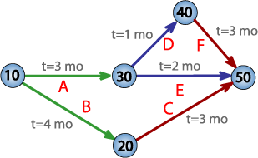
Pert charts
PERT = Project Evaluation and Review Technique
A, B, C … are the tasks/activities
t = 3 mo … time needed to complete the activity
10, 20, … are the milestones
Critical Path = the longest possible continuous pathway taken from the initial event to the terminal event. It determines the total time required for the project.
Example from Wikipedia
http://en.wikipedia.org/wiki/Program_Evaluation_and_Review_Technique
Critical path = 7 months

Slide 15
Making a good presentation
It’s amazing how little you need - don’t try to say too much, cram too much in…
bla bla…..
bla bla…..
bla bla…..
bla bla…..
bla bla…..
bla bla…..
bla bla…..
bla bla…..
bla bla…..
bla bla…..

Slide 16
Making a good presentation
It’s amazing how little you need - don’t try to say too much, cram too much in…
Don’t try to speak too quickly, people simply won’t process what you say…

Slide 17
Making a good presentation
It’s amazing how little you need - don’t try to say too much, cram too much in…
Don’t try to speak too quickly, people simply won’t process what you say…
Don’t worry about being a bit nervous!

Slide 18
Making a good presentation
Don’t worry about pausing to remember what you want to say - gives the audience a chance to think about what you have said so far

Slide 19
Making a good presentation
Don’t worry about pausing to remember what you want to say - gives the audience a chance to think about what you have said so far
But try to respect the time allocated for the presentation:
  Practice
  Check your clock at key-points of the presentation
  In long talks, identify optional slides that you can possibly skip

Slide 20
Making a good presentation
Try to speak aloud

Slide 21
Making a good presentation
Try to speak aloud
Look at the audience

Slide 22
Making a good presentation
Try to speak aloud
Look at the audience
Try to give a simple take-home message

Slide 23
Making a good presentation
Try to speak aloud
Look at the audience
Try to give a simple take-home message
Make jokes? (after 10-15 minutes 90% of the audience is typically sleeping…)

Slide 24
Structuring a PowerPoint pack
(Expecially for the PR3 presentations)
About one minute per slide…if you go quicker, people just glaze over!

Slide 25
Structuring a PowerPoint pack
(Expecially for the PR3 presentations)
About one minute per slide…if you go quicker, people just glaze over!
Need a good introductory slide giving a clear statement of the argument

Slide 26
Structuring a PowerPoint pack
(Expecially for the PR3 presentations)
About one minute per slide…if you go quicker, people just glaze over!
Need a good introductory slide giving a clear statement of the argument
A number of slides to develop the presentation

Slide 27
Structuring a PowerPoint pack
(Expecially for the PR3 presentations)
About one minute per slide…if you go quicker, people just glaze over!
Need a good introductory slide giving a clear statement of the argument
A number of slides to develop the presentation
A clear conclusion (1 or 2 slides) - not a summary…

Slide 28
Title: at least 36 point
Text: 24 point is OK
If you have something complex you want audience to look at, give it out on paper, people cannot read detail from a slide

Slide 29
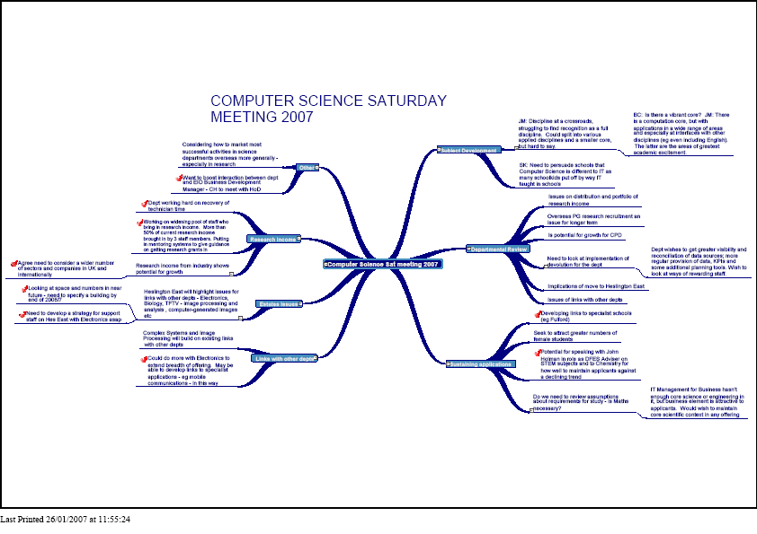
This doesn’t work

Slide 30
Clear Fonts
If you really fancy it (Arial)
Different fonts make a difference too (Times New Roman)
San serif fonts like Arial, Helvetica and Verdana are clear on a screen

Slide 31

Avoid distracting backgrounds
And excessively complicated slide designs

Slide 32
Just because Microsoft
Provides it, doesn’t mean it’s a good thing
For instance avoid the flying bullet
It just irritates the audience…

Slide 33
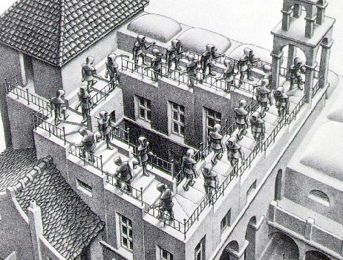
Rehearse and repeat … it will get better!

